Slide 1


OPERATIONS & METRIC ANALYTICS
PROJECT 3
NAME – Shalini Pathak
TRAINITY – Data Analytics Course

Slide 2
About Project
This project involves case study on Operation Analysis & Investagating Metric Spike.
The Operation Analysis is a process that monitor company’s data & discovery of insights to help team make better decision.
This analysis helps identify areas of improvement within the company by using real-time data.
The Investigating Metric Spike is One of the key aspects of Operational Analytics.
This involves understanding and explaining sudden changes in key metrics, it helps us to give data on daily basis like user engagement or update in a sales team or occurrence and activation time of a product.
Using this casestudy we will work with different data tables like ( job_data,users, events, email_events).
We will use MySql Workbench 8.0 CE.

Slide 3

CASE STUDY 1
Job Data Analysis

Slide 4
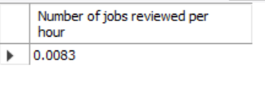
A) Jobs Reviewed Over Time
STEPS :-
To know the number of jobs reviewed per hour we need to count the distinct job_id.
Now we have to calculate jobs reviewed per hour for 30 days so we will multiply them i.e (30*24).
Now we need to divide the count of job_id by number of hours from job_data.
select count(distinct job_id)/(30*24)
as `Number of jobs reviewed per hour`
from job_data;

Slide 5
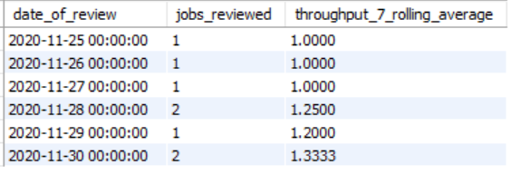
B) Throughput Analysis
SELECT ds as date_of_review,
jobs_reviewed,AVG(jobs_reviewed) OVER
(ORDER BY ds ROWS BETWEEN 6
PRECEDING AND CURRENT ROW)
AS throughput_7_rolling_average
FROM ( SELECT ds, COUNT( DISTINCT job_id)
AS jobs_reviewed FROM job_data
GROUP BY ds ORDER BY ds ) a;
STEPS :-
For calculating the through-put we will be using the 7-day rolling because it will give us an average of all days.
We will first take the count of job_id and order them w.r.t ds.
Use the Row function to consider the rows between 6 preceding rows and the current row 3.
Then we will take the average of all jobs_reviewed

Slide 6
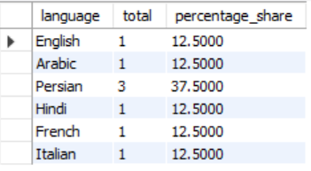
C) Language Share Analysis
STEPS :-
To know the language share we will firt count the total number of languages.
Now use a select query and count the total number of rows present.
Now we need to know the percentage share so we will divide the count of languages by count of rows present multipled by 100 as a percentage share from job data.
Do grouping based on languages.
select `language`,count(`language`) as total ,
((count(`language`)/(select count(*) from job_data))*100)
as percentage_share from job_data group by `language`;

Slide 8
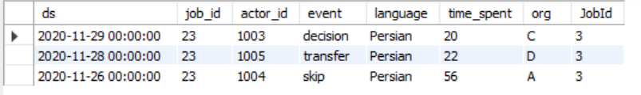
D) Duplicate Rows Detection
select * from (select * , count(*)
over (partition by job_id) as JobId
from job_data ) s where JobId > 1;
STEPS :-
To find the duplicate rows in the data we will first know the count of rows hence use nested select query.
Use over(partition by job_id) to partition the data into different job ids.
Once we get jobid
Use main select query and Select all from table where jobid > 1 this will give us the duplicate rows

Slide 9




CASE STUDY 2
Investigating Metric Spike

Slide 10
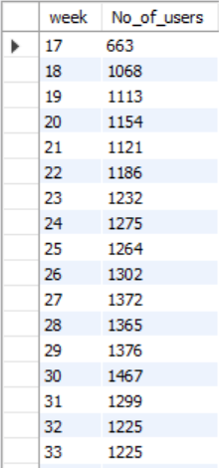
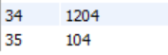
A) Weekly User Engagement
select extract(week from occurred_at) as `week`, count(distinct user_id) as No_of_users from events group by 1;
STEP :-
To know the weekly user engagement we need to extract week and count distinct userid.
We will use extract function for week (week from occurred_at).
Now count unique user id (distinct_user_id) from events table.
Use group by function to group the result by week.

Slide 11
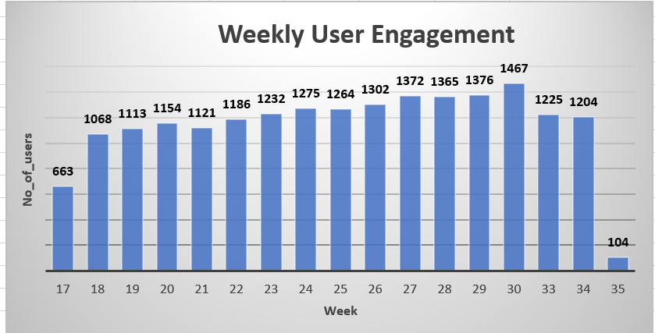

Slide 12
B) User Growth Analysis
STEPS :-
To find the user growth over time, we need to extract the year and week from activated_at column and then sum the current and preceding value of user count to find the cumulative number of users.
We will extract year and week from activated_at and will count unique users using count(distinct user_id).
We will then find sum of the count of distinct users over current and preceding row using window functions.
We will finally group and order the result by year number and week number.
select Year_Number, Week_Number,
No_of_users ,sum(No_of_users) over
(order by Year_Number,Week_Number rows
between unbounded preceding and current row )
as cumulative_no_of_users from
(select extract(year from u.activated_at)
as Year_Number ,extract(week from u.activated_at)
as Week_Number , count(distinct user_id)
as No_of_users from users u
group by Year_Number,Week_Number
order by Year_Number,Week_Number) u;
https://drive.google.com/file
/d/1_A9o1pbUcK8RkdLzGnC
ytEtTSwfx8sta/view?usp=sharing

Slide 13
C) Weekly Retention Analysis:
STEPS :-
To find the weekly retention of users, we will find the signup week and engagement week, then we will subtract the signup week from the engagement week, then we will sum the retention weeks.
We will left join the users and events table on the condition that user_id of both the tables must be same.
We will use extract and week functions to get signup and engagement weeks.
We will use conditional statements to find sum of weeks where retention week is 1.
We will then group and order the result by user_id.
select distinct user_id, count(user_id),
sum(case when retention_week = 1 then 1 else 0 end)
as week_of_retentionfrom (select A.user_id,
A.week_of_signup , B.week_of_engagement,
(B.week_of_engagement –
A.week_of_signup) as retention_week
from ((select distinct user_id,
extract(week from occurred_at)
as week_of_signup from `events`
where event_type = 'signup_flow' and
event_name = 'complete_signup') A left join
(select distinct user_id, extract(week from occurred_at)
as week_of_engagement from `events`
where event_type = 'engagement') B on
A.user_id = B.user_id)) C
group by user_id order by user_id;
https://drive.google.com/file/d/1_
xpfgurGEvSZM7FhRoGrhocibUGo-Gxq/view
?usp=sharing

Slide 14
D) Weekly Engagement Per Device:
STEPS :-
To find weekly engagement per device, we will extract year and week of occurred_at from events table using extract, year and week functions.
Then we will select device name and count the unique user ids using count(distinct user_id).
We will group and order the result by all the elements of select clause, i.e. year, week, device and count of users.
select extract(year from occurred_at) as `Year`,
extract(week from occurred_at)as `Week`,
device, count(distinct user_id) as No_of_users
from events group by 1,2,3 order by 1,2,3 ;
https://drive.google.com/file/d/
1r78ttpxFgjykuHmO0TbcU4cpi-Pm6fES/
view?usp=sharing

Slide 15
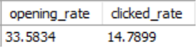
E) Email Engagement Analysis:
STEPS :-
To find email engagement metrics, we will first categorize the email events. If the event is 'sent_weekly_digest' or 'sent_reengagement_email', then it will go under 'sent' category. If the event is 'email_open', then it will go under 'opened' category. If the event is 'email_clickthrough', then it will go under 'clicked' category.
Then to find email opening rate, we will divide the sum of opened events by sum of sent events and multiply it by 100.
Then to find email clicked rate, we will divide the sum of clicked events by sum of sent events and multiply it by 100.
select (sum(case when event_type = 'opened’
then 1 else 0 end)/ sum(case when event_type = 'sent’
then 1 else 0 end))*100 as opening_rate,
(sum(case when event_type = 'clicked' then 1 else 0 end) /
sum(case when event_type = 'sent' then 1 else 0 end))*100
as clicked_ratefrom
(select *, case when action in('sent_weekly_digest’,
'sent_reengagement_email') then 'sent’
when action in('email_open') then 'opened’
when action in('email_clickthrough') then 'clicked’
end as event_type from email_events) E

